Slide 1
Binary search trees
David Kauchak CS 140 – Spring 2024

Slide 2
Admin
Assignment 3 out
Partner assignment
Can work with anyone
Coding + paper (two separate submissions)

Slide 3
Binary Search Trees
BST – A binary tree where a parent’s value is greater than all values in the left subtree and less than or equal to all the values in the right subtree
And the left and right children are also binary search trees
Why not?
Ambiguous about where elements that are equal would reside

Slide 4
Example
12
8
14
5
9
20
Can be implemented with with references or an array

Slide 5
What else can we conclude?
12
The smallest element is the left-most element
The largest element is the right-most element
8
14
5
9
20

Slide 6
Another example: the solo tree
12

Slide 7
Another example: the twig
12
8
5
1

Slide 8
Operations
Search(T, k) – Does value k exist in tree T
Insert(T, k) – Insert value k into tree T
Delete(T, x) – Delete node x from tree T
Minimum(T) – What is the smallest value in the tree?
Maximum(T) – What is the largest value in the tree?
Successor(T, x) – What is the next element in sorted order after x
Predecessor(T, x) – What is the previous element in sorted order of x
Median(T) – return the median of the values in tree T

Slide 9
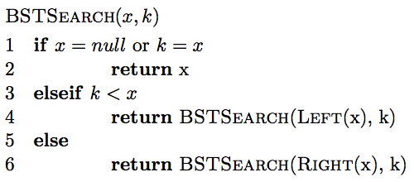
Search
How do we find an element?

Slide 10
Finding an element
Search(T, 9)
12
8
14
5
9
20

Slide 11
Finding an element
Search(T, 9)
12
8
14
5
9
20

Slide 12
Finding an element
Search(T, 9)
12
8
14
5
9
20
9 > 12?

Slide 13
Finding an element
Search(T, 9)
12
8
14
5
9
20

Slide 14
Finding an element
Search(T, 9)
12
8
14
5
9
20

Slide 15
Finding an element
Search(T, 9)
12
8
14
5
9
20

Slide 16
Finding an element
Search(T, 13)
12
8
14
5
9
20

Slide 17
Finding an element
Search(T, 13)
12
8
14
5
9
20

Slide 18
Finding an element
Search(T, 13)
12
8
14
5
9
?
20

Slide 19
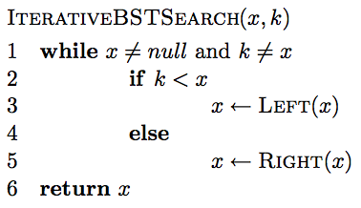
Iterative search

Slide 20
Is BSTSearch correct?

Slide 21
Running time of BSTSearch
Worst case?
θ(height of the tree)
Average case?
O(height of the tree)
Best case?
O(1)

Slide 22
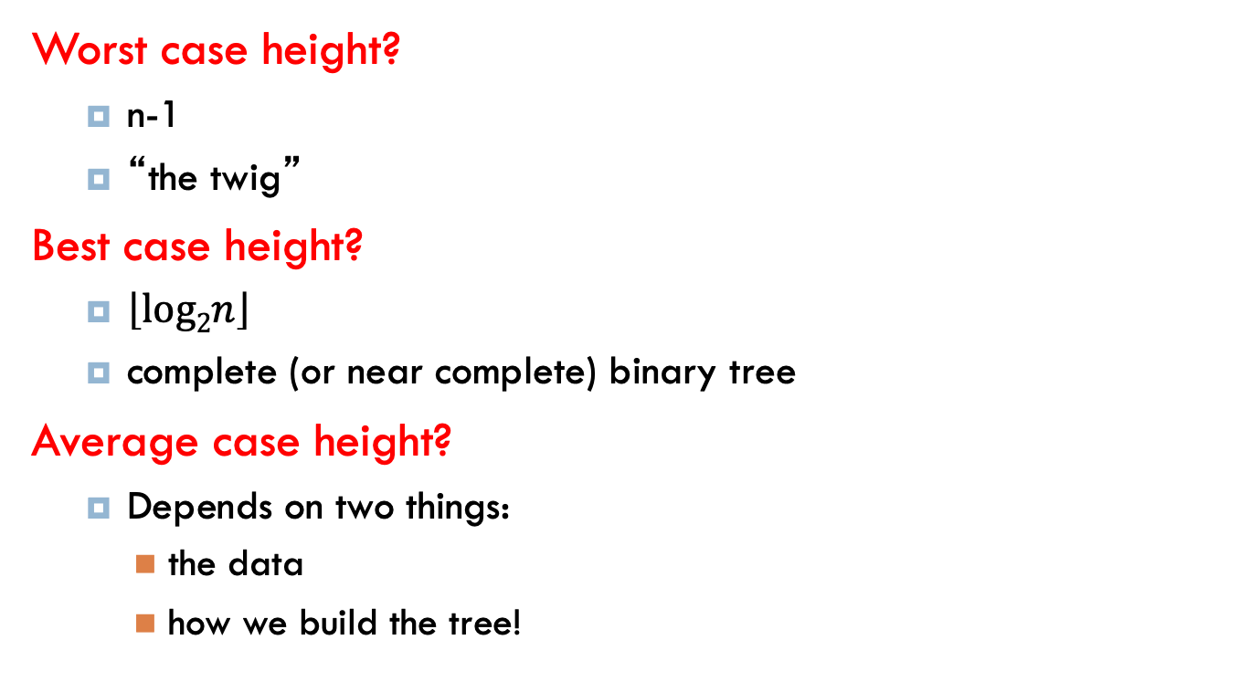
Height of the tree
Worst case height?
n-1
“the twig”
Best case height?
$\left\lfloor log2n\right\rfloor$
complete (or near complete) binary tree
Average case height?
Depends on two things:
the data
how we build the tree!

Slide 23
Insertion
Search and then insert when you find a “null” spot in the tree.

Slide 24
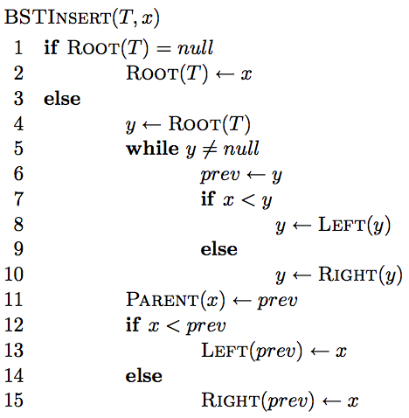
Insertion

Slide 25
Insertion
Like search

Slide 26
Insertion
Similar to search
Find the correct location in the tree

Slide 27
Insertion
keeps track of the previous node we visited so when we fall off the tree, we know

Slide 28
Insertion
add node onto the bottom of the tree

Slide 29
Correctness?
maintain BST property

Slide 30
Correctness
What happens if it is a duplicate?

Slide 31
Inserting duplicates
Insert(T, 14)
12
8
14
5
9
20

Slide 32
Inserting duplicates
Insert(T, 14)
12
8
14
5
9
20
14

Slide 33
Running time
Search and then insert when you find a “null” spot in the tree
O(height of the tree)

Slide 34
Running time
Search and then insert when you find a “null” spot in the tree
O(height of the tree)
When we use Big Theta, we are asserting that the function has both an upper and a lower bound at the given rate.
In the case of BST operations, we use O(height of the tree) instead of Θ(height of the tree) because:
- The worst case is indeed O(height of the tree), which occurs when the BST is unbalanced and resembles a linked list (in which case the height is n).
- The best case (the tree is perfectly balanced) is Θ(log n), and the height is log n.
Since Θ implies a tight bound (both upper and lower bounds are the same), it's not used for general BSTs because we cannot guarantee the lower bound to be logarithmic; it could be linear in the worst case.
Why not Θ(height of the tree)?

Slide 35
Running time
Insert(T, 15)
12
8
5
1

Slide 36
Height of the tree
Worst case: “the twig” – When will this happen?
Search and then insert when you find a “null” spot in the tree
Notes:
sorted or inversely sorted data (and there are other cases as well)

Slide 37
Height of the tree
Best case: “complete” – When will this happen?
Search and then insert when you find a “null” spot in the tree

Slide 38
Height of the tree
Average case for random data?
Search and then insert when you find a “null” spot in the tree.
Randomly inserting data into a BST generates a tree on average that is O(log n).

Slide 39
Visiting all nodes
In sorted order
12
8
14
5
9
20

Slide 40
Visiting all nodes
In sorted order
5
12
8
14
5
9
20

Slide 41
Visiting all nodes
In sorted order
5, 8
12
8
14
5
9
20

Slide 42
Visiting all nodes
In sorted order
5, 8, 9
12
8
14
5
9
20

Slide 43
Visiting all nodes
In sorted order
5, 8, 9, 12
12
8
14
5
9
20

Slide 44
Visiting all nodes
What’s happening?
5, 8, 9, 12
12
8
14
5
9
20

Slide 45
Visiting all nodes
In sorted order
5, 8, 9, 12, 14
12
8
14
5
9
20

Slide 46
Visiting all nodes
In sorted order
5, 8, 9, 12, 14, 20
12
8
14
5
9
20

Slide 47
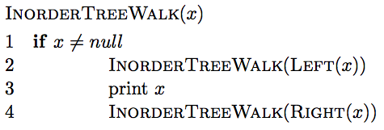
Visiting all nodes in order

Slide 48
Visiting all nodes in order
any operation

Slide 49
Is it correct?
Does it print out all of the nodes in sorted order?

Slide 50
Running time?
Recurrence relation:
j nodes in the left subtree
n – j – 1 in the right subtree
Or
How much work is done for each call?
How many calls?
Θ(n)

Slide 51
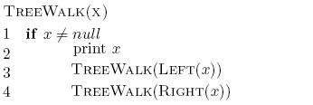
What about?

Slide 52
Preorder traversal
12, 8, 5, 9, 14, 20
Tree copying: insert in to new tree in preorder
prefix notation: (2+3)*4 -> * + 2 3 4
How is this useful?
12
8
14
5
9
20

Slide 53
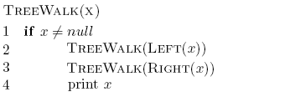
What about?

Slide 54
Postorder traversal
5, 9, 8, 20, 14, 12
postfix notation: (2+3)*4 -> 4 3 2 + *
?
How is this useful?
12
8
14
5
9
20

Slide 55
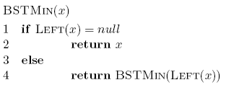

Min/Max
12
8
14
5
9
20

Slide 56
Running time of min/max?
O(height of the tree)

Slide 57
Successor and predecessor
Predecessor(12)?
9
12
8
14
5
9
13
20

Slide 58
Successor and predecessor
Predecessor in general?
The predecessor is the largest node of all those smaller than this node.
12
It is the rightmost element of the left subtree which means “go left once, then go right until you hit the right-most leaf.”
8
14
5
9
13
20

Slide 59
Successor
13
Successor(12)?
12
8
14
5
9
13
20

Slide 60
Successor
Successor in general?
It is smallest node of all those larger than this node.
Leftmost element of the right subtree.
12
8
14
5
9
13
20

Slide 61
Successor
What if the node doesn’t have a right subtree?
smallest node of all those larger than this node
leftmost element of the right subtree
12
8
14
5
9
13
20

Slide 62
Successor
What if the node doesn’t have a right subtree?
The node is the largest
The successor is the node that has x as a predecessor
12
8
14
5
9
13
20

Slide 63
Successor
The successor is the node that has x as a predecessor
12
8
14
5
9
13
20

Slide 64
Successor
successor is the node that has x as a predecessor
12
8
14
5
9
13
20

Slide 65
Successor
successor is the node that has x as a predecessor
12
8
14
5
9
13
20

Slide 66
Successor
We keep going up until we (x) are no longer a right child.
successor is the node that has x as a predecessor
12
8
14
5
9
13
20

Slide 67
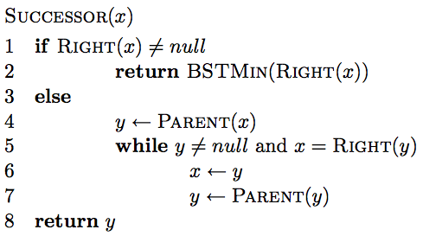
Successor

Slide 68
Successor
If we have a right subtree, return the smallest of the right subtree

Slide 69
Successor
Find the node that x is the predecessor of
Keep going up until we’re no longer a right child.

Slide 70
Successor running time
O(height of the tree)

Slide 71
Deletion
12
8
14
5
9
13
20
Three cases!

Slide 72
Deletion: case 1
No children
Just delete the node
12
8
14
5
9
13
20
17

Slide 73
Deletion: case 1
No children
Just delete the node
12
8
14
5
13
20
17

Slide 74
Deletion: case 2
One child
Splice out the node
12
8
14
5
13
20
17

Slide 75
Deletion: case 2
One child
Splice out the node
12
5
14
13
20
17

Slide 76
Deletion: case 3
Two children
Replace x with its successor
12
5
14
13
20
17

Slide 77
Deletion: case 3
Two children
Replace x with its successor
12
5
17
13
20

Slide 78
Deletion: case 3
Two children.
Will we always have a successor?
Why successor?
Larger than the left subtree
Less than or equal to right subtree.

Slide 79
Height of the tree
Most of the operations take time O(height of the tree)
We said trees built from random data have height O(log n), which is asymptotically tight.
Two problems:
We can’t always insure random data
What happens when we delete nodes and insert others after building a tree?

Slide 80
Balanced trees
Make sure that the trees remain balanced!
Red-black trees
AVL trees
2-3-4 trees
…
B-trees

Slide 81
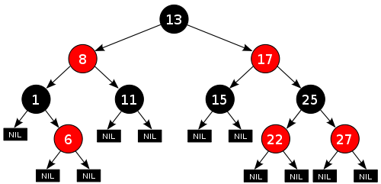
Red-black trees: BST (plus some)
every node is either red or black
root is black
leaves (NIL) are black
if a node is red, both children are black
for every node, all paths from the node to descendant leaves contain the same number of black nodes.
https://en.wikipedia.org/wiki/Red–black_tree

Slide 82
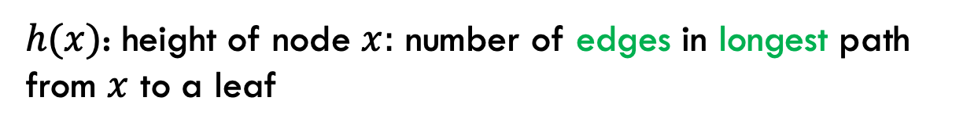
Red-black trees: BST (plus some)
every node is either red or black
root is black
leaves (NIL) are black
if a node is red, both children are black
for every node, all paths from the node to descendant leaves contain the same number of black nodes.
$h(x)$: height of node $x:$ number of edges in longest path from $x$ to a leaf

Slide 83

Red-black trees: BST (plus some)
$h(x)$: height of node $x:$ number of edges in longest path from $x$ to a leaf
What is the height of the root node?

Slide 84
Red-black trees: BST (plus some)
$h(x)$: height of node $x:$ number of edges in longest path from $x$ to a leaf
4

Slide 85
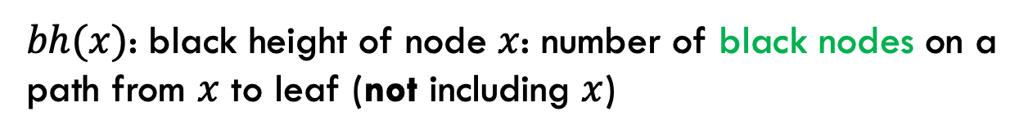
Red-black trees: BST (plus some)
every node is either red or black
root is black
leaves (NIL) are black
if a node is red, both children are black
for every node, all paths from the node to descendant leaves contain the same number of black nodes.
$bh(x)$: black height of node $x$: number of black nodes on a path from $x$ to leaf (not including $x$)
Why don’t we say ”path with the most…”?

Slide 86
Red-black trees: BST (plus some)
every node is either red or black
root is black
leaves (NIL) are black
if a node is red, both children are black
for every node, all paths from the node to descendant leaves contain the same number of black nodes.
$bh(x)$: black height of node $x$: number of black nodes on a path from $x$ to leaf (not including $x$)
Why don’t we say ”path with the most…”?

Slide 87

Red-black trees: BST (plus some)
$bh(x)$: black height of node $x$: number of black nodes on a path from $x$ to leaf (not including $x$).
What is the black height of the root node?

Slide 88
Red-black trees: BST (plus some)
$bh(x)$: black height of node $x$: number of black nodes on a path from $x$ to leaf (not including $x$)
2

Slide 89
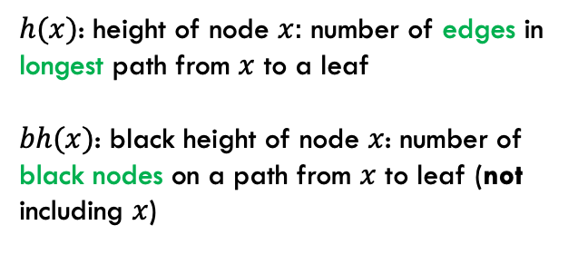
Bounding the height
every node is either red or black
root is black
leaves (NIL) are black
if a node is red, both children are black
for every node, all paths from the node to descendant leaves contain the same number of black nodes.
$h(x)$: height of node $x:$ number of edges in longest path from $x$ to a leaf
$bh(x)$: black height of node $x$: number of black nodes on a path from $x$ to leaf (not including $x$)
Claim 1: For every node $x$, $bh\left(x\right)≥h(x)/2$
Proof?

Slide 90
Bounding the height
every node is either red or black
root is black
leaves (NIL) are black
if a node is red, both children are black
for every node, all paths from the node to descendant leaves contain the same number of black nodes.
$h(x)$: height of node $x:$ number of edges in longest path from $x$ to a leaf
$bh(x)$: black height of node $x$: number of black nodes on a path from $x$ to leaf (not including $x$)
Claim 1: For every node $x$, $bh\left(x\right)≥h(x)/2$
Worst case: nodes alternate red/black
root is black
leaf is black
In terms of h(x): How many black nodes are there on this path?

Slide 91
Bounding the height
every node is either red or black
root is black
leaves (NIL) are black
if a node is red, both children are black
for every node, all paths from the node to descendant leaves contain the same number of black nodes.
$h(x)$: height of node $x:$ number of edges in longest path from $x$ to a leaf
$bh(x)$: black height of node $x$: number of black nodes on a path from $x$ to leaf (not including $x$)
Claim 1: For every node $x$, $bh\left(x\right)≥h(x)/2$
Worst case: nodes alternate red/black
root is black
leaf is black
…

Slide 92

Bounding the height
every node is either red or black
root is black
leaves (NIL) are black
if a node is red, both children are black
for every node, all paths from the node to descendant leaves contain the same number of black nodes.
$h(x)$: height of node $x:$ number of edges in longest path from $x$ to a leaf
$bh(x)$: black height of node $x$: number of black nodes on a path from $x$ to leaf (not including $x$)
Claim 1: For every node $x$, $bh\left(x\right)≥h(x)/2$
Worst case: nodes alternate red/black
root is black
leaf is black
…
$$bh\left(x\right)=h(x)/2$$
(Note that bh does not include the root)

Slide 93

Bounding the height
every node is either red or black
root is black
leaves (NIL) are black
if a node is red, both children are black
for every node, all paths from the node to descendant leaves contain the same number of black nodes.
$h(x)$: height of node $x:$ number of edges in longest path from $x$ to a leaf
$bh(x)$: black height of node $x$: number of black nodes on a path from $x$ to leaf (not including $x$)
Claim 1: For every node $x$, $bh\left(x\right)≥h(x)/2$
Worst case: nodes alternate red/black
root is black
leaf is black
…
$$bh\left(x\right)≥h(x)/2$$
We can remove red nodes, but that would decrease h(x)

Slide 94

Bounding the height
Claim 2: The subtree rooted at any node $x$ contains at least $2^{bh(x)}−1$ internal (non-leaf) nodes.
Proof?

Slide 95
Structural induction
Want to prove something about a recursive structure (e.g., a tree).

Slide 96

Structural induction
$$x$$
Proof by induction:
IH: Assume the property holds for sub-structures (i.e., subtrees).
Show that it holds for the entire tree.

Slide 97
Structural induction
$$x$$
Base case is often the smallest structure possible (e.g., a leaf).

Slide 98

Bounding the height
Claim 2: The subtree rooted at any node $x$ contains at least $2^{bh(x)}−1$ internal (non-leaf) nodes
Base case:

Slide 99
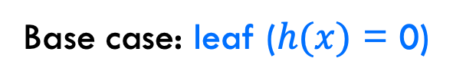
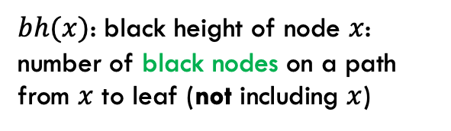


Bounding the height
Claim 2: The subtree rooted at any node $x$ contains at least $2^{bh(x)}−1$ internal (non-leaf) nodes
Base case: leaf ($h(x)$ = 0)
$$bh\left(x\right)= 0$$
$bh(x)$: black height of node $x$: number of black nodes on a path from $x$ to leaf (not including $x$)
$$2^{0}−1=0$$

Slide 100
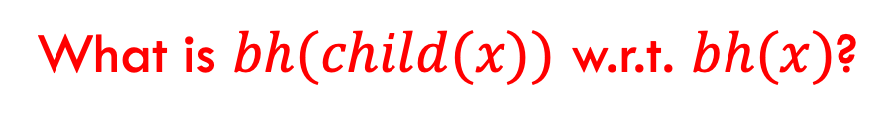
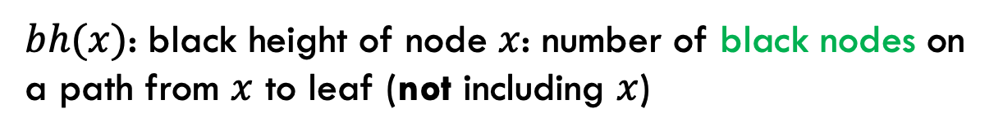

Bounding the height
Claim 2: The subtree rooted at any node $x$ contains at least $2^{bh(x)}−1$ internal (non-leaf) nodes
Inductive case: $h(x)$ > 0
IH: Assume $2^{bh(y)}−1$ for all y that are subtrees of x
What is $bh(child(x))$ w.r.t. $bh(x)$?
$bh(x)$: black height of node $x$: number of black nodes on a path from $x$ to leaf (not including $x$)

Slide 101
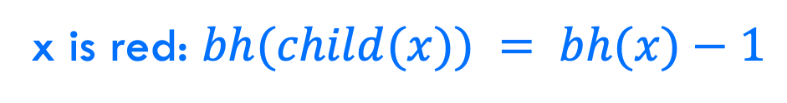


Bounding the height
Claim 2: The subtree rooted at any node $x$ contains at least $2^{bh(x)}−1$ internal (non-leaf) nodes
Inductive case: $h(x)$ > 0
IH: Assume $2^{bh(y)}−1$ for all y that are subtrees of x
x is red: $bh(child(x)) = bh(x)−1$
$bh(x)$: black height of node $x$: number of black nodes on a path from $x$ to leaf (not including $x$)

Slide 102
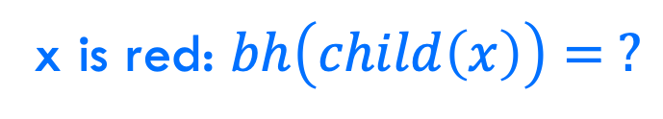


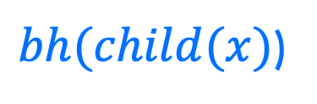
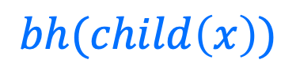
Bounding the height
x is red: $bh\left(child\left(x\right)\right)= ?$
$$x$$
$$bh(child\left(x\right))$$
$bh(child(x)$)
$bh(x)$: black height of node $x$: number of black nodes on a path from $x$ to leaf (not including $x$)

Slide 103
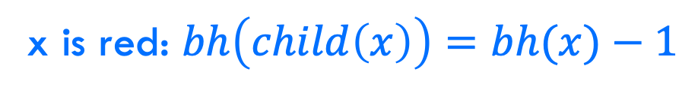
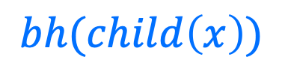
Bounding the height
x is red: $bh\left(child\left(x\right)\right)=bh(x)−1$
$$x$$
$$bh(child\left(x\right))$$
$$bh(child\left(x\right))$$
$bh(x)$: black height of node $x$: number of black nodes on a path from $x$ to leaf (not including $x$)

Slide 104
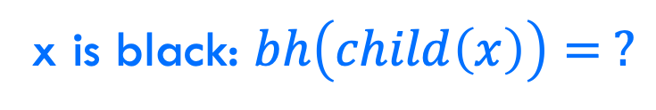
Bounding the height
x is black: $bh\left(child\left(x\right)\right)= ?$
$$x$$
$$bh(child\left(x\right))$$
$$bh(child\left(x\right))$$
$bh(x)$: black height of node $x$: number of black nodes on a path from $x$ to leaf (not including $x$)

Slide 105




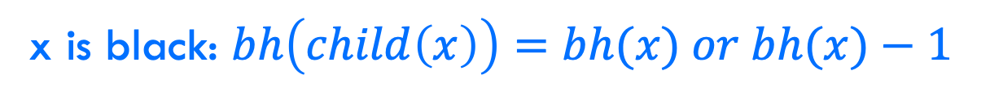

Bounding the height
x is black: $bh\left(child\left(x\right)\right)=bh(x) or bh(x)−1$
$$x$$
$$x$$
$$bh(child\left(x\right))$$
$$bh(child\left(x\right))$$
$$bh(child\left(x\right))$$
$bh(x)$: black height of node $x$: number of black nodes on a path from $x$ to leaf (not including $x$)

Slide 106
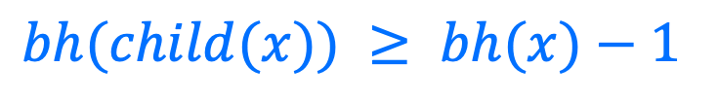
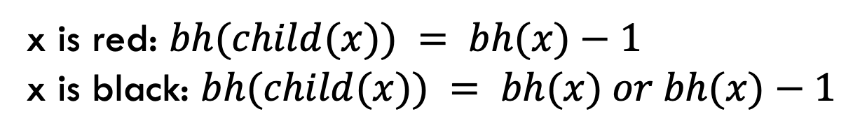
Bounding the height
Claim 2: The subtree rooted at any node $x$ contains at least $2^{bh(x)}−1$ internal (non-leaf) nodes
Inductive case: $h(x)$ > 0
IH: Assume $2^{bh(y)}−1$ for all y that are subtrees of x
x is red: $bh(child(x)) = bh(x)−1$
x is black: $bh(child(x)) = bh(x) or bh(x)−1$
$bh(child(x)) ≥ bh(x)−1$

Slide 107


Bounding the height
Claim 2: The subtree rooted at any node $x$ contains at least $2^{bh(x)}−1$ internal (non-leaf) nodes
Inductive case: $h(x)$ > 0
IH: Assume $2^{bh(y)}−1$ for all y that are subtrees of x
$bh(child(x)) ≥ bh(x)−1$
$$x$$
How many (internal nodes are in this tree (at least)?

Slide 108



Bounding the height
Claim 2: The subtree rooted at any node $x$ contains at least $2^{bh(x)}−1$ internal (non-leaf) nodes
Inductive case: $h(x)$ > 0
IH: Assume $2^{bh(y)}−1$ for all y that are subtrees of x
$bh(child(x)) ≥ bh(x)−1$
$$x$$
$$1$$
$$2^{bh\left(x\right)−1}−1$$
$$2^{bh\left(x\right)−1}−1$$

Slide 109

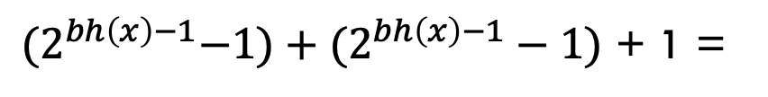
Bounding the height
Claim 2: The subtree rooted at any node $x$ contains at least $2^{bh(x)}−1$ internal (non-leaf) nodes
Inductive case: $h(x)$ > 0
IH: Assume $2^{bh(y)}−1$ for all y that are subtrees of x
$bh(child(x)) ≥ bh(x)−1$
${(2}^{bh\left(x\right)−1}−1)+(2^{bh\left(x\right)−1}−1)$ + 1 =
$$2^{bh\left(x\right)}−1$$

Slide 110
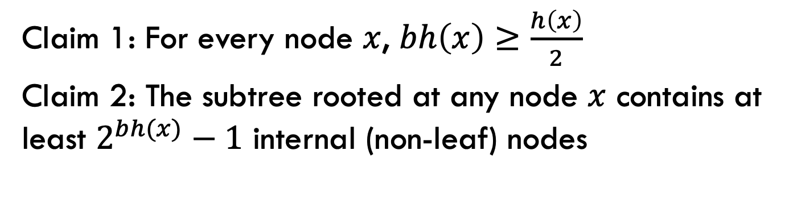
Bounding the height (almost there!)
Claim 1: For every node $x$, $bh\left(x\right)≥\frac{h\left(x\right)}{2}$
Claim 2: The subtree rooted at any node $x$ contains at least $2^{bh(x)}−1$ internal (non-leaf) nodes
How does this help us?

Slide 111

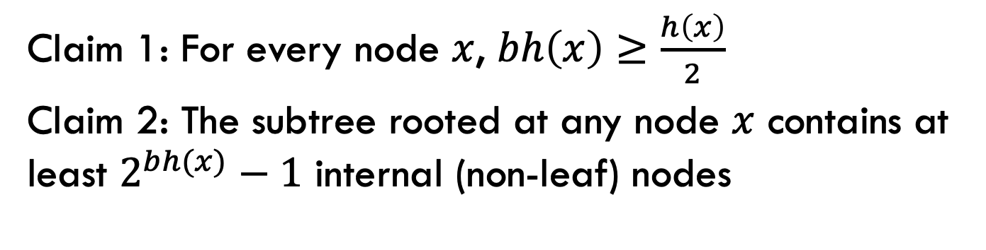



Bounding the height
Claim 1: For every node $x$, $bh\left(x\right)≥\frac{h\left(x\right)}{2}$
Claim 2: The subtree rooted at any node $x$ contains at least $2^{bh(x)}−1$ internal (non-leaf) nodes
${n ≥2}^{bh(x)}−1$
Claim 2
Claim 1
${n ≥2}^{h(x)/2}−1$
math
$${n+1 ≥2}^{h(x)/2}$$
math
$$h\left(x\right) ≤2log⁡(n+1)$$
What does this mean?

Slide 112
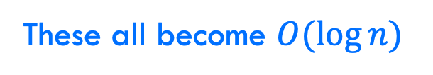
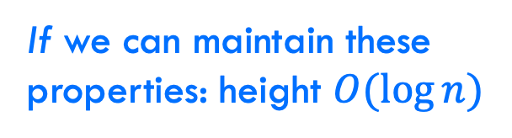
Bounding the height
every node is either red or black
root is black
leaves (NIL) are black
if a node is red, both children are black
for every node, all paths from the node to descendant leaves contain the same number of black nodes.
If we can maintain these properties: height $O(log⁡n)$
Search
Insert
Delete
Maximum
These all become $O(\log{n})$

Slide 113
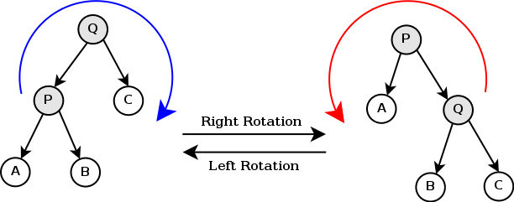
Can it be done?
Can we maintain the red-black tree properties without making insertion and deletion more expensive?
https://en.wikipedia.org/wiki/Tree_rotation#/media/File:Tree_rotation.png

Slide 114
A quick example
https://www.youtube.com/watch?v=vDHFF4wjWYU

Slide 115
Number guessing game
I’m thinking of a number between 1 and n
You are trying to guess the answer
For each guess, I’ll tell you “correct”, “higher” or “lower”
Describe an algorithm that minimizes the number of guesses

